Slide 1
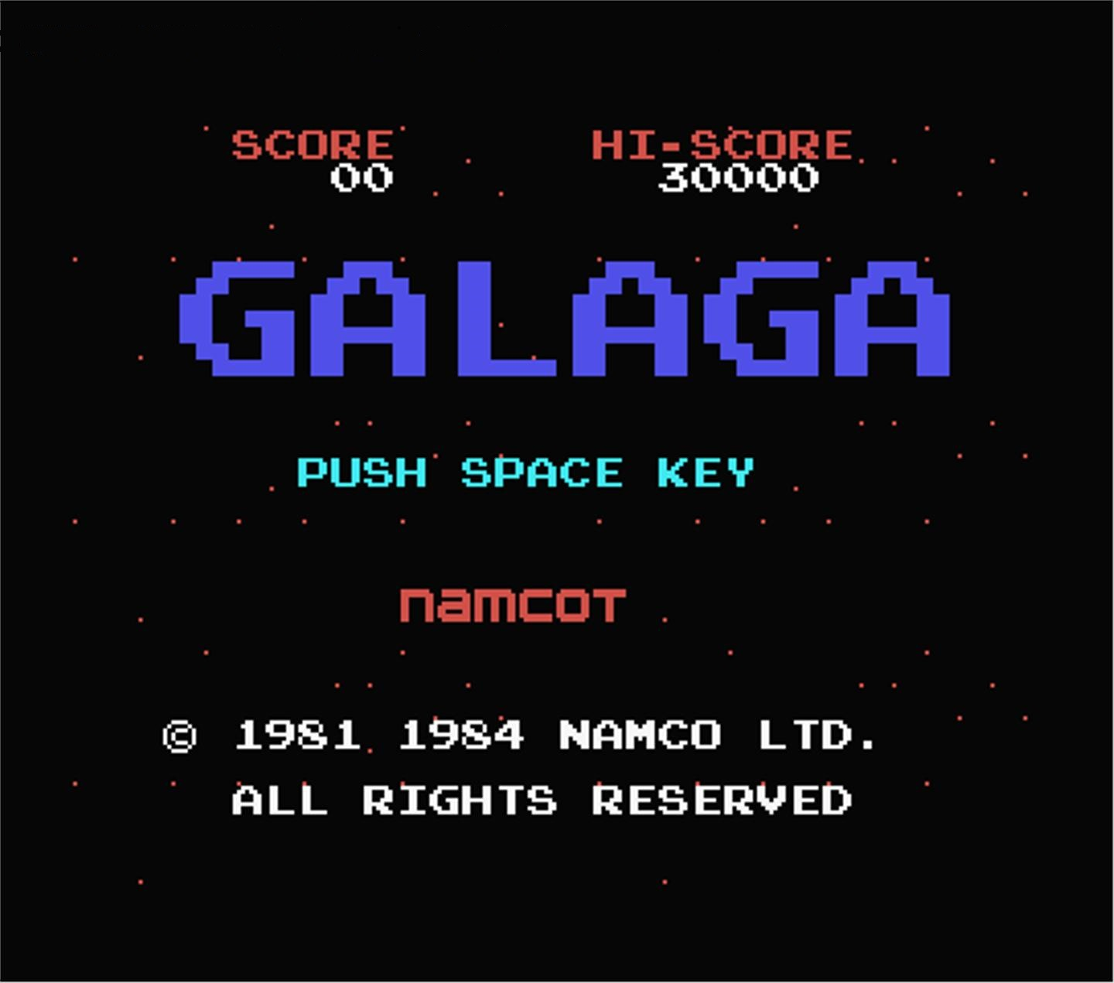
REMAKE
Brandon goh nian zhou – 121309D
Kho liang hao – 121320s
Ron ng jian yian - 120160y
Sim yuan he - 12XXXXd

